Slide 1

BLACKFYRE REBELLION
ULTIMATE TIC TAC TOE

Slide 2

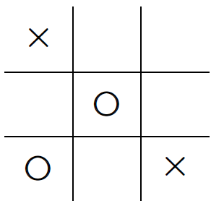
REGULAR GAME RULES

Slide 3
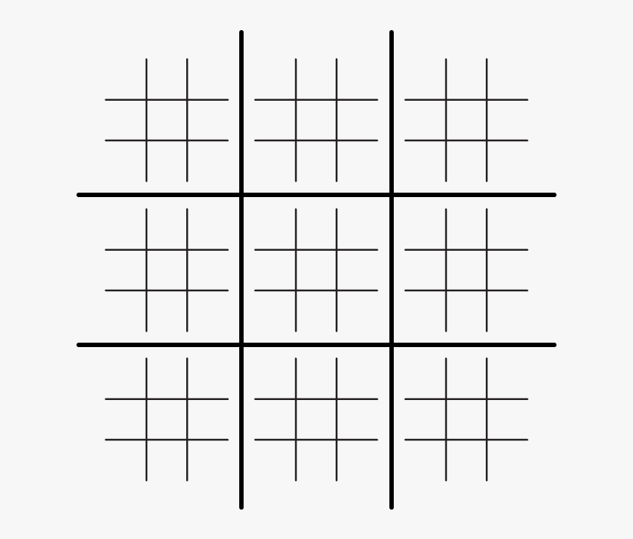
ULTIMATE GAME RULES

Slide 4
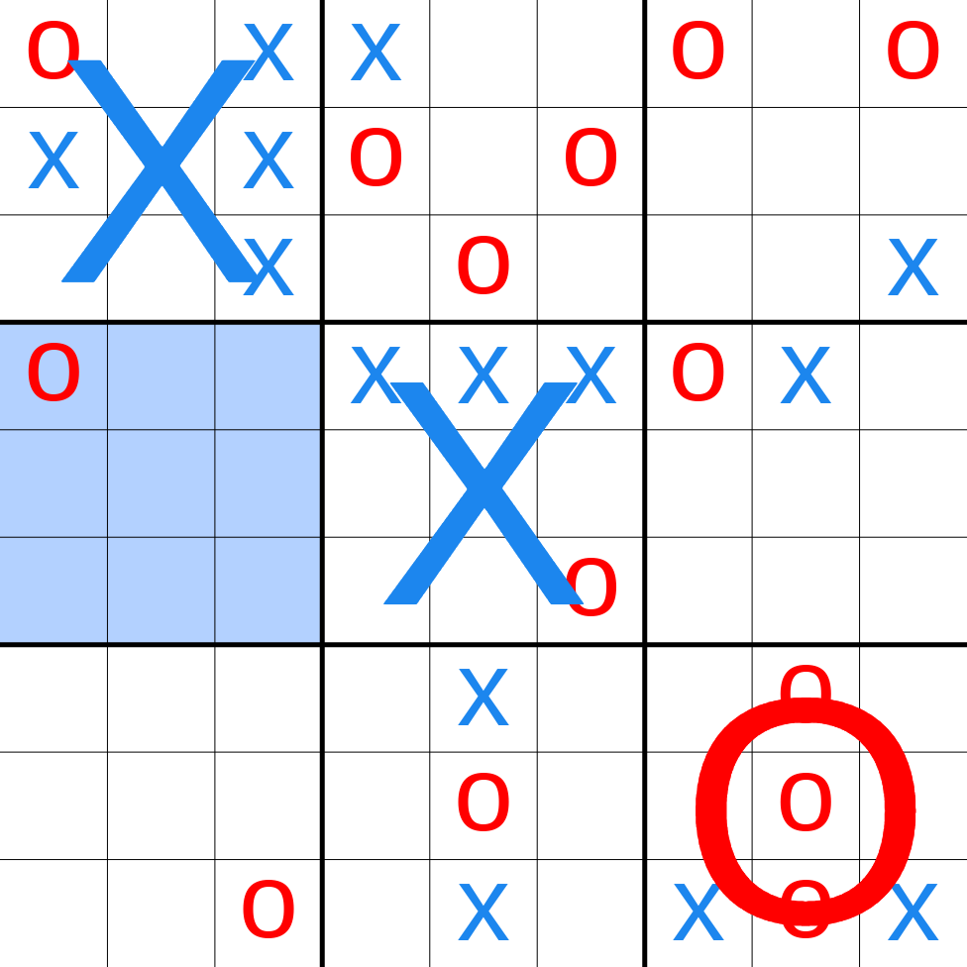

Slide 5
CLASS HANDLING
PROPERTIES:
Int [][]Grids;
Int state;
METHODS:
getGrid returns the grid for the object
getX Y returns coordinates
getState returns the state of the object
setGrid changes grid after game played
setState sets the state after each game played

Slide 6
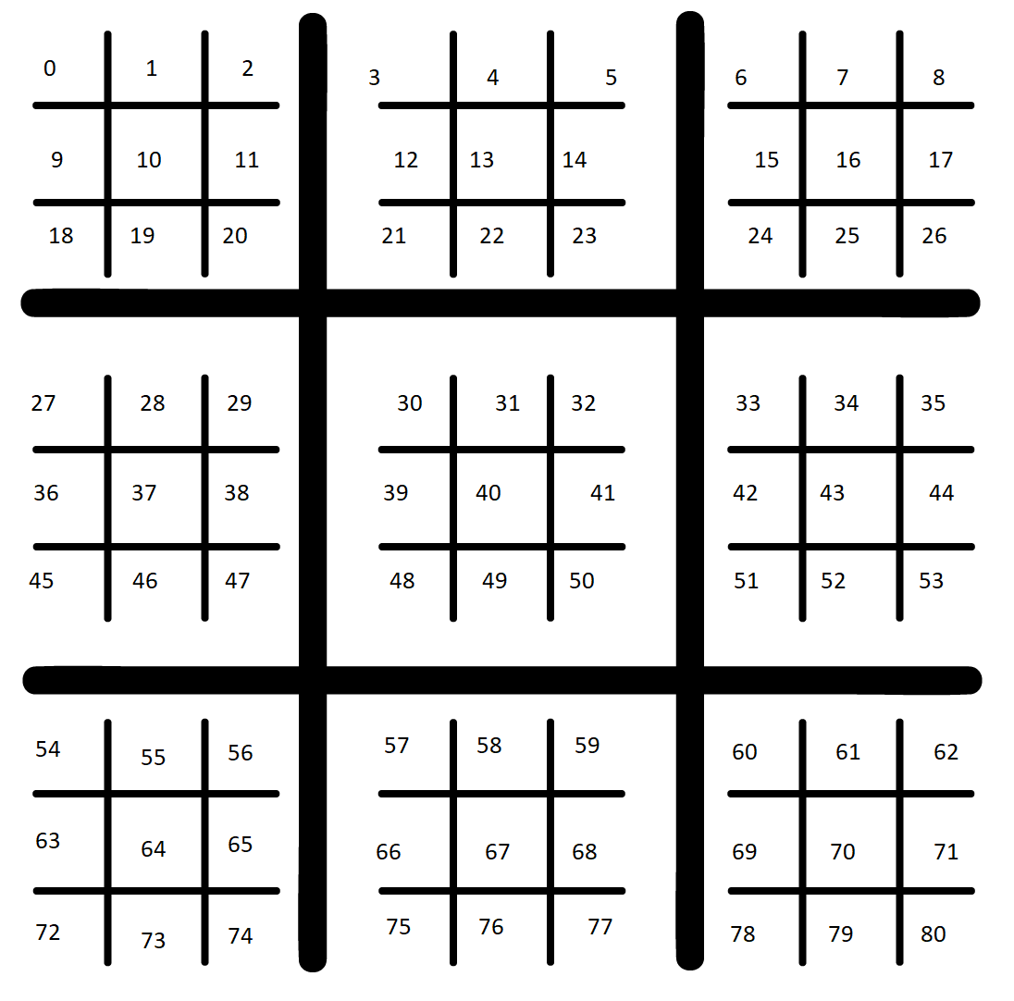
Numbered Buttons

Slide 7
Formulae used
Grid selection :
X = button number / 27
Y = (button number % 9) / 3
Next Grid Navigation :
X = (button number / 9)%3
Y = button number % 3

Slide 8

Fundamental Functions
Check_Across (int [][] grids)
returns true or false and an integer (1,-1,0)
Check_Diagonal (int [][] grids)
returns true or false and an integer (1,-1,0)
Stalemate(int [][] grids)
returns true or false
Check_Holder(int [][] states)

Slide 9
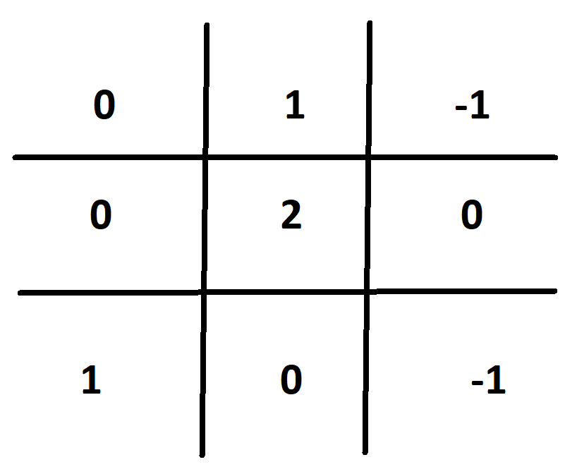
State Arrays

Slide 10
GAME TESTING

